Slide 1



XVI Joint Colloquium of the Byurakan and Abastumani Astrophysical Observatories
Abastumani, 23-27.09.2024
Astrophysical Implications of Magnetically Anisotropic Dilute Plasma Flows
Alexander Tevzadze
E. Kharadze Georgian National Astrophysical Observatory

Slide 2
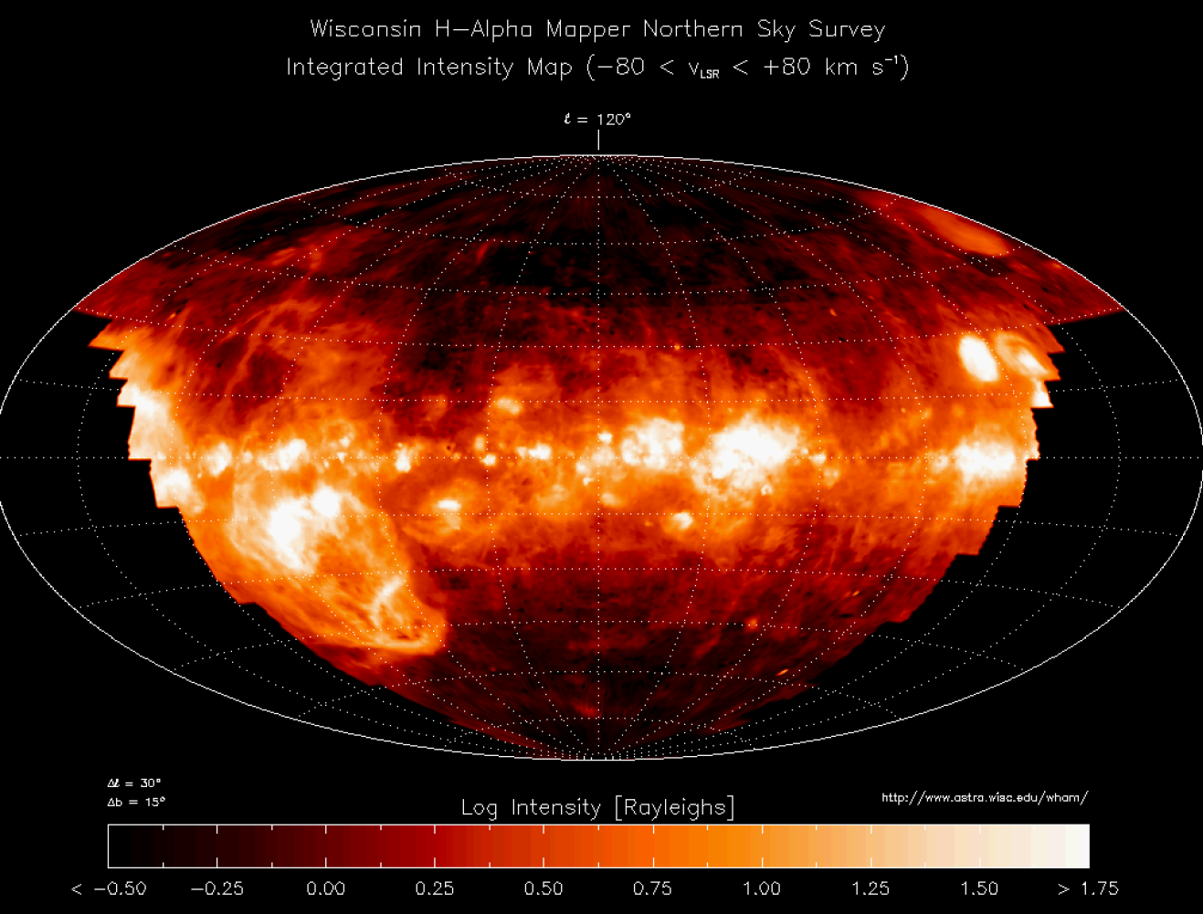
Dilute Plasma in the Universe
Dilute plasma in our galaxy
“hot” areas of interstellar plasma:
T ~ 10⁵ - 10⁷ K
Intergalactic: 1 – 0.1 ion/cm³
Intracluster: 10⁻¹ – 10⁻⁵ ion/cm³
Collisionless Plasma
Thermal Effects (Low Frequency)
Magnetic Field Anisotropy
XVI Joint Colloquium of the Byurakan and Abastumani Astrophysical Observatories 27.09.2024

Slide 3
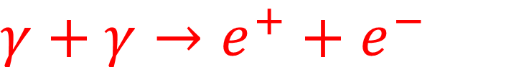
Large Scale Plasmas in the Universe
Magnetic fields with large scale correlation length:
Galactic Magnetic Fields: 10⁻⁶ Gauss
Galactic Clusters
Intracluster Magnetic Fields
(Neronov, Vovk 2010) B > 10⁻¹⁶ Gauss
TeV:
Astrophysical/Cosmological origin of B fields
$γ+γ→e^{+}+$ $e^{−}$
XVI Joint Colloquium of the Byurakan and Abastumani Astrophysical Observatories 27.09.2024

Slide 4
Description of the Dilute Plasmas
Diffuse magnetized plasmas in the universe is dilute
collision freq. is much lower then Larmor freq. ν/Ω <<1
(dilute, collisionless, weakly collisional)
Exact description: Kinetic Theory (Boltzmann Equation)
Particle distribution function; micro physics + fluid effects;
micro instabilities; fluid instabilities; (highly complex formalism)
When does the magnetized plasma can be described as “fluids”?
Collision freq. is much higher then fluid frequencies ν/ω >>1
XVI Joint Colloquium of the Byurakan and Abastumani Astrophysical Observatories 27.09.2024

Slide 5
Astrophysical Implications
Dilute collisionless astrophysical plasmas at different scales:
Solar and Stellar winds
Stability of directional outflows
Micro/Macro instabilities
Intracluster and Cosmic Plasmas
Large scale coherent magnetic fields
Universe expansion
XVI Joint Colloquium of the Byurakan and Abastumani Astrophysical Observatories 27.09.2024

Slide 6
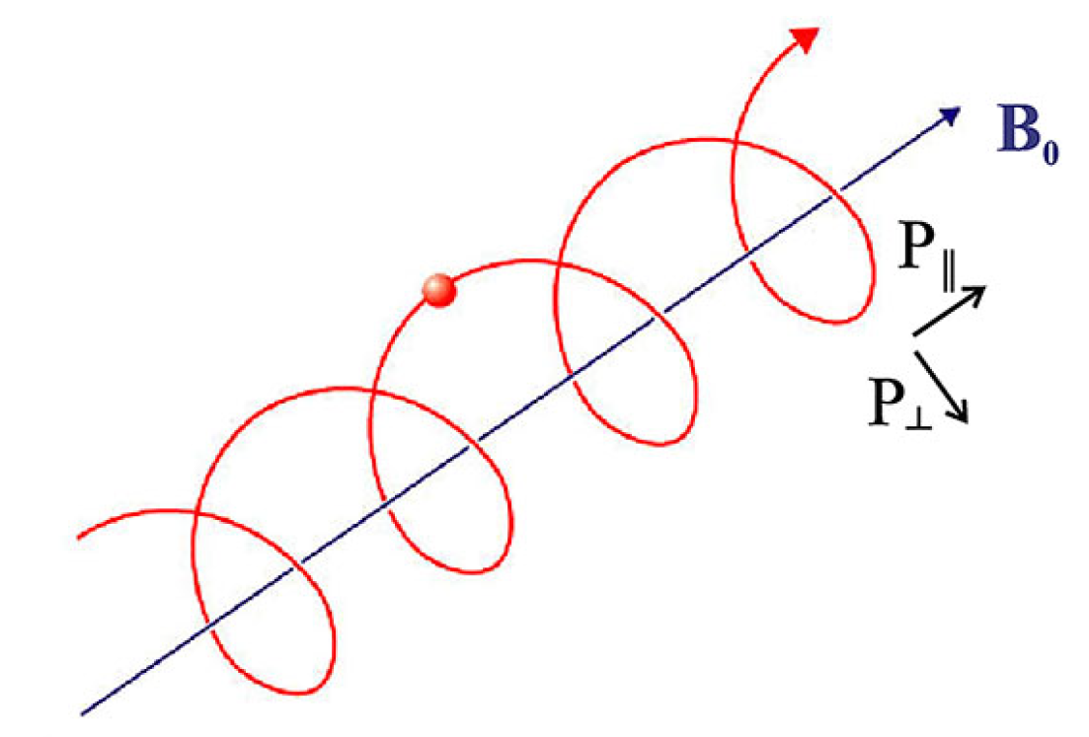
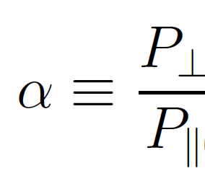
Anisotropic Plasmas
Charged particles undergo “gyration” under the influence
of magnetic Lorenz force.
Temperature/Pressure along and perpendiculat to
The magnetic field are different.
Anisotropy parameter
T|| ≠ T ┴, P|| ≠P┴
XVI Joint Colloquium of the Byurakan and Abastumani Astrophysical Observatories 27.09.2024

Slide 7
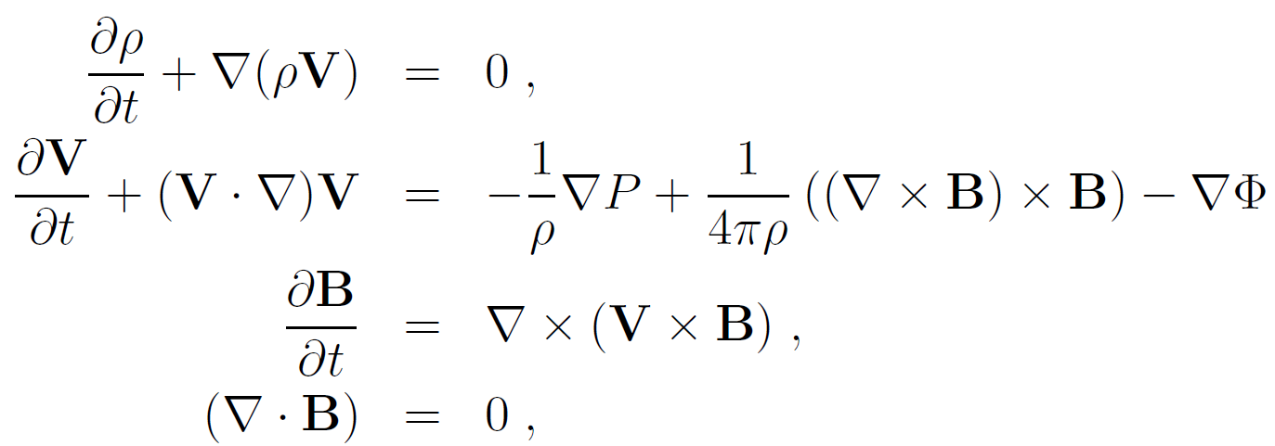
Theoretical Description
If we insist on fluid description of dilute plasmas,
pressure can not be isotropic.
Anisotropic MHD models
(one fluid, one component)
Anisotropic MHD should be able to resolve micro physics (micro instabilities) within simple one fluid (component) formalism. Anisotropic MHD Lab: the solar wind;
Can we be still successful with “naive” MHD at large scales?
XVI Joint Colloquium of the Byurakan and Abastumani Astrophysical Observatories 27.09.2024

Slide 8
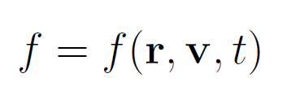
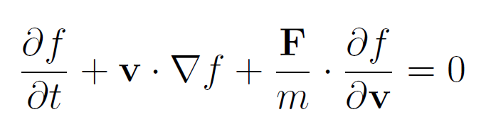
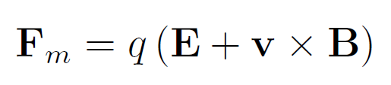
Kinetic Theory: Problems
Particle probability distribution function:
Boltzmann Equation in magnetic field (without collisions term):
XVI Joint Colloquium of the Byurakan and Abastumani Astrophysical Observatories 27.09.2024

Slide 9
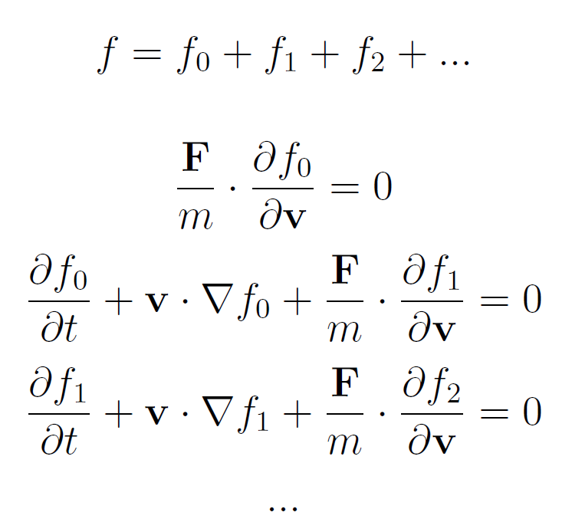
Kinetic Theory: Problems
Expansion with respect to F/M
Hierarchy problem.
Closure model?
XVI Joint Colloquium of the Byurakan and Abastumani Astrophysical Observatories 27.09.2024

Slide 10

Kinetic Closure Models: Adiabatics
Isotropic “one fluid” MHD
Equation of State:
CGL (Chew Goldberger Low) MHD
“double adiabatic”
state (P||, P┴):
Neglecting heat fluxes
(high freq. processes)
MHD waves + micro physics (Mirror and Fire-hose instabilities)
$$P=Cρ^{γ}$$
XVI Joint Colloquium of the Byurakan and Abastumani Astrophysical Observatories 27.09.2024

Slide 11
Kinetic Closure Models: Anisotropic Viscosity
Anisotropic viscosity MHD (Braginskii MHD)
(Braginskii 1965, Hollweg 1985)
ν – viscosity parameter
Local (viscous) properties of anisotropic plasmas
XVI Joint Colloquium of the Byurakan and Abastumani Astrophysical Observatories 27.09.2024

Slide 12
Closure Models: Heat Fluxes
(Oraevski et al. 1968, Ramos 2003)
“Heat Fluxes”: S
4th order “Equation of State”
XVI Joint Colloquium of the Byurakan and Abastumani Astrophysical Observatories 27.09.2024

Slide 13
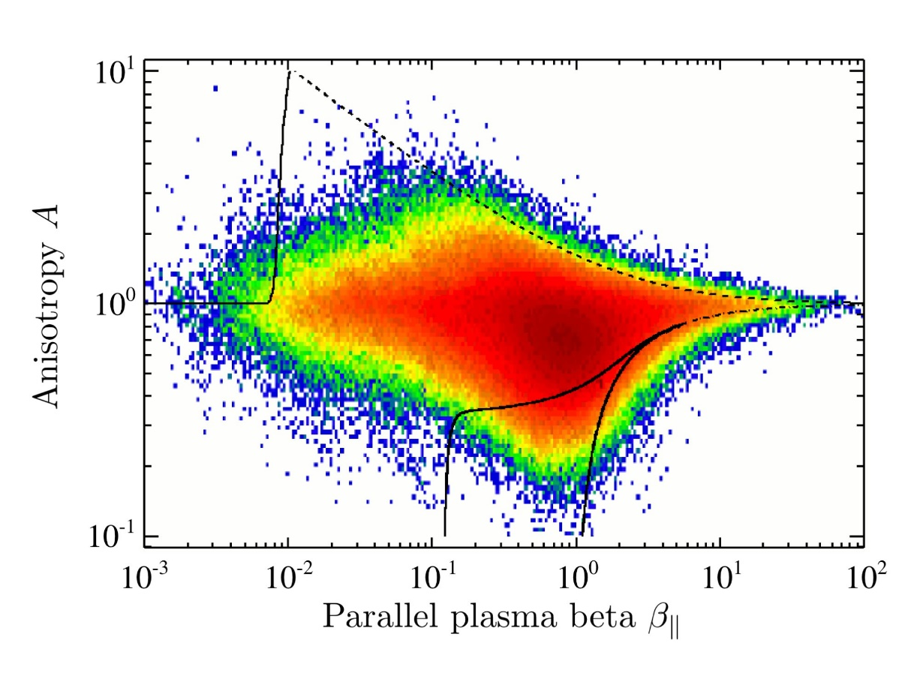
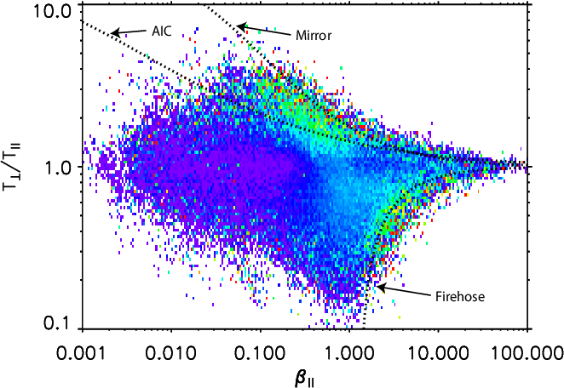
Solar Wind
Observations of Solar Wind Plasma Fluxtuations
Anisotropy parameter vs parallel plasma beta
(Schlickeiser et al. 2011)
What are microscopic
processes inhibiting
fluctuations on the
left areas?
XVI Joint Colloquium of the Byurakan and Abastumani Astrophysical Observatories 27.09.2024

Slide 14

CM Heat Fluxes: Thermo-acoustic modes
Anisotropic MHD flow in parallel magnetic field
Parameters: $γ={S_{||}}/{P_{||}C_{||}}$ $α={P_{\text{⊥ }}}/{P_{||}}$
Strong magnetic field:
CGL MHD HF MHD
“acoustic mode”
“fast and slow thermo-acoustic modes”
XVI Joint Colloquium of the Byurakan and Abastumani Astrophysical Observatories 27.09.2024

Slide 15
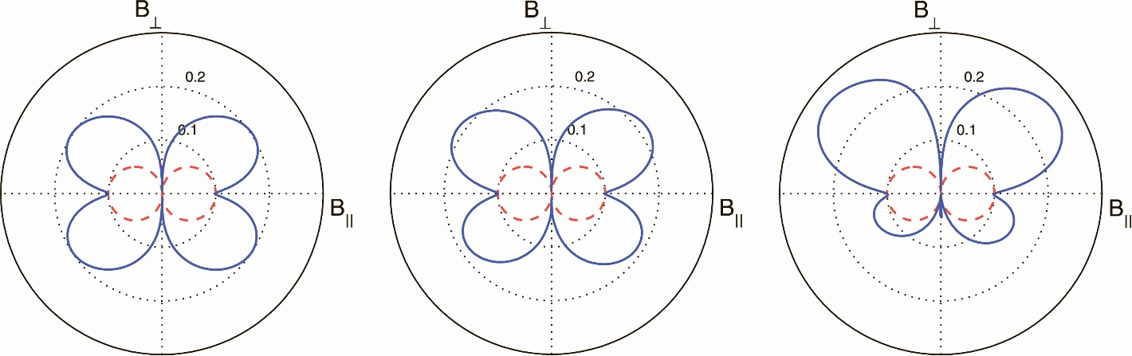
CM Heat Fluxes: Fire-Hose instability
Assymetry of the growth of the fire-hose instability due to combined action of velocity shear and heat fluxes
α = 0.5, β|| = 2, k_{z} = 1,
c²_{F} = −0.01, R = 0.2,
q⊥ = 0.2, 2, 10,
XVI Joint Colloquium of the Byurakan and Abastumani Astrophysical Observatories 27.09.2024

Slide 16
CM Heat Fluxes: Solar Wind
Long way to go … (especially at turbulent/nonlinear regime);
Development of linear micro instabilities?
Heat flux instability: limits maximal possible γ
Mirror and Fire-hose family: mimic collision effects through nonlinearities?
Anisotropic MHDs saturates to classical MHD?
Small scales ? MHD dynamo (micro phys. can be important)
Knowing what questions to ask – right way forward
XVI Joint Colloquium of the Byurakan and Abastumani Astrophysical Observatories 27.09.2024

Slide 17
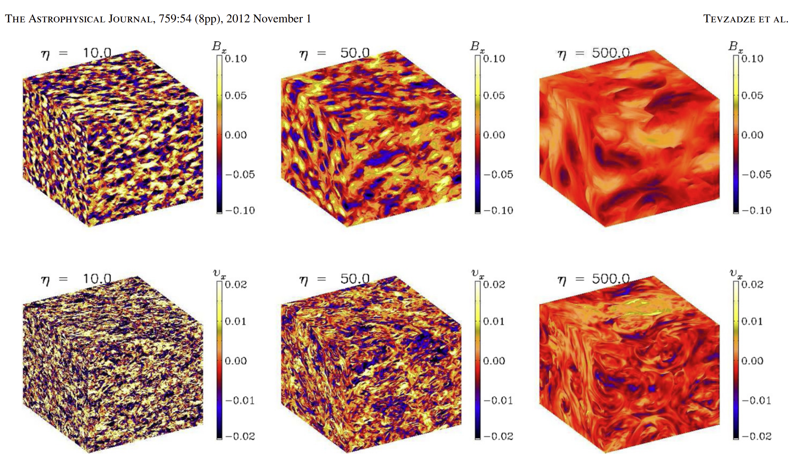
Cosmic Plasma Expansion
Cosmic MHD Turbulence:
Evolution of B Field:
Cosm. phase transitions
MHD Turbulence
Turbulence decay
XVI Joint Colloquium of the Byurakan and Abastumani Astrophysical Observatories 27.09.2024

Slide 18

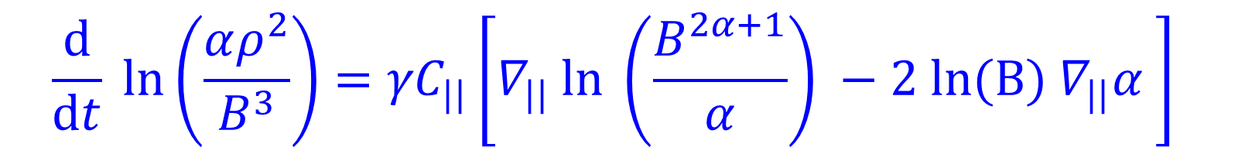
Cosmic Plasma Expansion
Large scale magnetic field evolution in decaying anisotropic MHD turbulence;
Stochastic magnetic field with no mean component:
Anisotropy axis is changing stochastically.
(isotropic, turbulence spectrum)
Reformulate 16 momentum MHD EOS:
$γ={S_{||}}/{P_{||}C_{||}}$, $α={P_{\text{⊥ }}}/{P_{||}}$ , $∇_{||} ≡ \frac{\text{B}}{\text{B}}∙∇$
$$\frac{\text{d}}{\text{d}t} \text{ln}\left(\frac{αρ^{2}}{B^{3}}\right)={γC}_{||}\left[∇_{||} \text{ln} \left(\frac{B^{2α+1}}{α}\right) −2 \text{ln}\text{(}\text{B}\text{) }∇_{||}α \right]$$
XVI Joint Colloquium of the Byurakan and Abastumani Astrophysical Observatories 27.09.2024

Slide 19


Cosmic Plasma Expansion
Assumptions:
Turbulence fluctuations: incompressible;
Constant anisotropy parameters: α, γ .
Fluctuation frequency:
Fluctuating scale: integral scale of turbulence;
Effective magnetic field:
CGL MHD:
Braginskii MHD:
$B_{\text{eff}}∝ γ\left(2α+1\right){\left(nT\right)}^{1/2}$
$B_{\text{eff}}=0$
$B_{\text{eff}}∝const.$
XVI Joint Colloquium of the Byurakan and Abastumani Astrophysical Observatories 27.09.2024

Slide 20
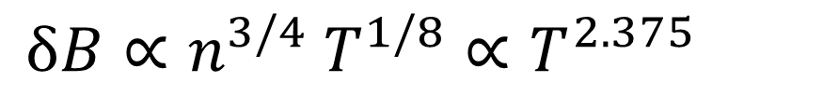
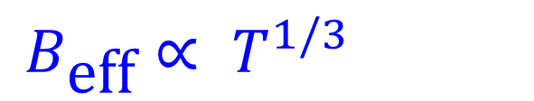
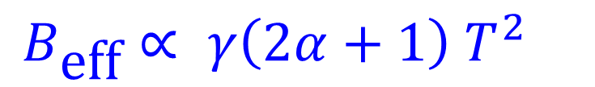
Cosmic Plasma Expansion
Comparison of the Magnetic Field decay laws:
Helical MHD turbulence:
Anisotropic MHD with Heat Fluxes:
Kinetic fluctuations:
$B_{\text{eff}}∝ T^{1/3}$
$B_{\text{eff}}∝ γ\left(2α+1\right) T^{2}$
$δB∝n^{3/4} T^{1/8}∝T^{2.375}$
XVI Joint Colloquium of the Byurakan and Abastumani Astrophysical Observatories 27.09.2024

Slide 21
Cosmic Plasma Expansion
Heat Flux asymmetric MHD can be used to describe effects of anisotropy in dilute plasmas at large scales;
MHD turbulence decay (helical, or not) predicts higher magnetic field energy then by anisotropic MHD state with constant α and γ.
Possible outcomes
Anisotropy and/or heat flux effects grow:
Anisotropy effects change turbulence spectral shape;
XVI Joint Colloquium of the Byurakan and Abastumani Astrophysical Observatories 27.09.2024

Slide 22
Conclusions
Anisotropic closure model with heat fluxes reveals an effective tool to analize dilute magnetized plasma flows in the universe;
Heat fluxes significantly modify micro (kinetic) instabilities and influence stability of solar/stellar winds
Expansion laws of the dilute magnetized plasma significantly differs from standard MHD turbulence decay, or adiabatic expansion laws, and should be taken into account when calculating present values of the primordial seed/amplified magnetic fields;
XVI Joint Colloquium of the Byurakan and Abastumani Astrophysical Observatories 27.09.2024

Slide 23
Thank you
Շատ շնորհակալ եմ
Հարցե՞ր:
XVI Joint Colloquium of the Byurakan and Abastumani Astrophysical Observatories 27.09.2024

