Slide 1



3rd IMA Conference on Dense Granular Flows
Centre for Mathematical Sciences, Cambridge, 01-04 July 2019
Viscorotational shear instability in
astrophysical dense granular flows
Alexander Tevzadze
Tbilisi State University, Georgia
Abastumani Astrophysical Observatory, Georgia
In collaboration with: Luka Poniatowski (KULeuven, Belgium)

Slide 2
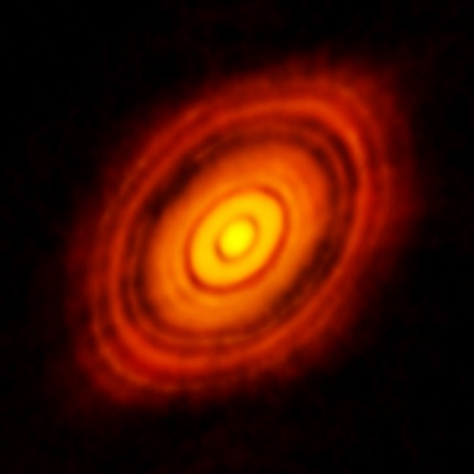
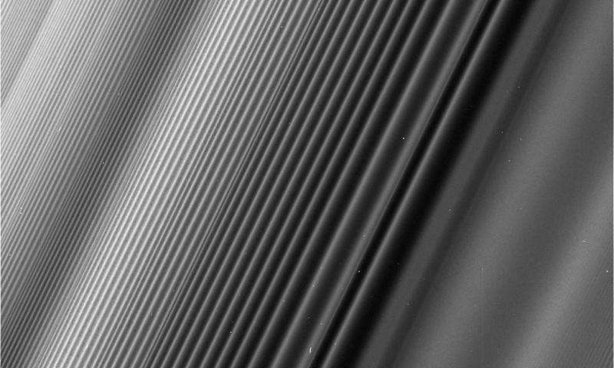
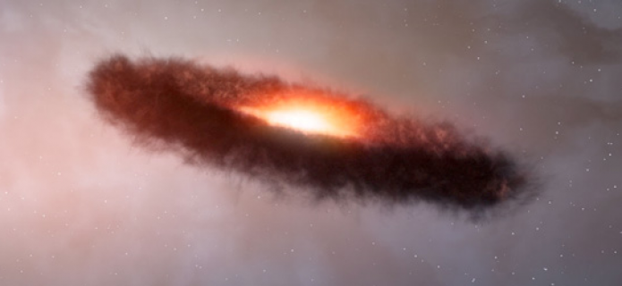
Granular Flows in Astrophysics
Planetary Rings
Exo-Planetary Rings
Debris Discs
Protoplanetary Discs
Differentially rotating “Keplerian flows”:
Particles rotate on their gravitational orbits
Granular pressure comparable with residual gravitational pressure
3rd IMA Conference on Dense Granular Flows Cambridge, 01-04 July 2019

Slide 3
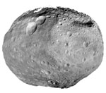
Planet Formation
Sizes of solid particles
1μ m → 10 km
dust→ planetesimal
Particle collisions: coagulation, scattering, fragmentation
Core accretion theory: ~1 meter barrier
a) Fluid model: nonlinear dynamics of anticycl. vortices;
b) Fluid-Particle model: “streaming instability”;
c) Particle-Particle collisions? granular fluid;
3rd IMA Conference on Dense Granular Flows Cambridge, 01-04 July 2019

Slide 4
Granular Liquids
Granular flow behavior
Strongly depends on the
Particle restitution coefficient.
Granular liquid
of inelastic particles
can be observed for
a wide range of
particle filling factors
Granular Rheology
of disc flows
3rd IMA Conference on Dense Granular Flows Cambridge, 01-04 July 2019

Slide 5
Viscous Stability
Turbulent (anomalous) viscosity α-model: ν_{eff} = αhc
Shakura Syunyaev 1973
σ – surface density (opacity)
a) Viscous Instability: β<-1 (incompressible)
Lightman, Eardley 1974, Shakura Syunyaev 1976
Viscous stress is proportional to radiation pressure?
b) Viscous Overstability: β>2 (compressible)
Kato 1978, Blumenthal et al. 1984
Increase of viscous stress in compressed d-spiral wave;
3rd IMA Conference on Dense Granular Flows Cambridge, 01-04 July 2019

Slide 6
Dense Granular Flow Model
Incompressible flow;
Constant Gravitational Potential;
Granular Viscosity;
Tensor formulation; (Jop, Forterre & Pouliquen 2006)
Local Constitutive Law
3rd IMA Conference on Dense Granular Flows Cambridge, 01-04 July 2019

Slide 7
Dense Granular Flow Model
Equations of motion in cylindrical co-ordinates
3rd IMA Conference on Dense Granular Flows Cambridge, 01-04 July 2019

Slide 8
Linear Perturbations
Viscosity fluctuations:
Pressure rheology parameter:
Shear rheology parameter:
3rd IMA Conference on Dense Granular Flows Cambridge, 01-04 July 2019

Slide 9
Linear Perturbation Analysis
Co-rotating
cylindrical frame:
Shearing sheet
(Kelvin modes)
Differential rotation → Planar shear flow
Shearing sheet modes
3rd IMA Conference on Dense Granular Flows Cambridge, 01-04 July 2019

Slide 10
Linear Stability Analysis
Solutions of the dispersion equation:
Epicyclic frequency in Newtonian fluids:
Rheological modification:
and
3rd IMA Conference on Dense Granular Flows Cambridge, 01-04 July 2019

Slide 11
Linear Stability Analysis
Transient growth:
Pressure rheology effects:
Shear (strain) effects:
Epicyclic modification:
3rd IMA Conference on Dense Granular Flows Cambridge, 01-04 July 2019

Slide 12
Instability
Linear instabilities:
Case 1: Pressure rheology:
“viscous instability” (cf. β<-1)
Case 2: Shear rheology:
- Keplerian flow:
- Power law constitutive eq.:
3rd IMA Conference on Dense Granular Flows Cambridge, 01-04 July 2019

Slide 13
Visco-rotational Shear Instability
Vertically uniform perturbations:
Shear rheology:
Arbitrary differential rotation:
1) q>0, Gs>0; (q_{K}=3/2)
2) q<0, Gs<0;
radial
differential rotation
Angular velocity of rotation
shear rheology
3rd IMA Conference on Dense Granular Flows Cambridge, 01-04 July 2019

Slide 14
Instability Spectra
1) Pressure rheology instability:
Large scale
“Viscous instability”
2) Shear rheology instability:
Small scale
“Visco-rotational instability”
3rd IMA Conference on Dense Granular Flows Cambridge, 01-04 July 2019

Slide 15
Instability Spectra
3) Instability of disk flow
with pressure and shear
rheologies:
4) Instability of non-axisymmetric
Perturbations:
3rd IMA Conference on Dense Granular Flows Cambridge, 01-04 July 2019

Slide 16
Summary
Shear and Pressure rheology effects on linear waves in Keplerian discs.
New type of linear instability:
“visco-rotational shear” instability
Incompressible, shear rheology,
Epicyclic destabilization of perturbations;
Exponential growth of the perturbation velocity curl in the shear plane;
Constitutive law dependence of particle sizes?
Nonlinear development: numerical simulations?
3rd IMA Conference on Dense Granular Flows Cambridge, 01-04 July 2019

Slide 17
Thank You
3rd IMA Conference on Dense Granular Flows Cambridge, 01-04 July 2019

Slide 18
Equilibrium Disc Flow
3rd IMA Conference on Dense Granular Flows Cambridge, 01-04 July 2019

